Slide 1
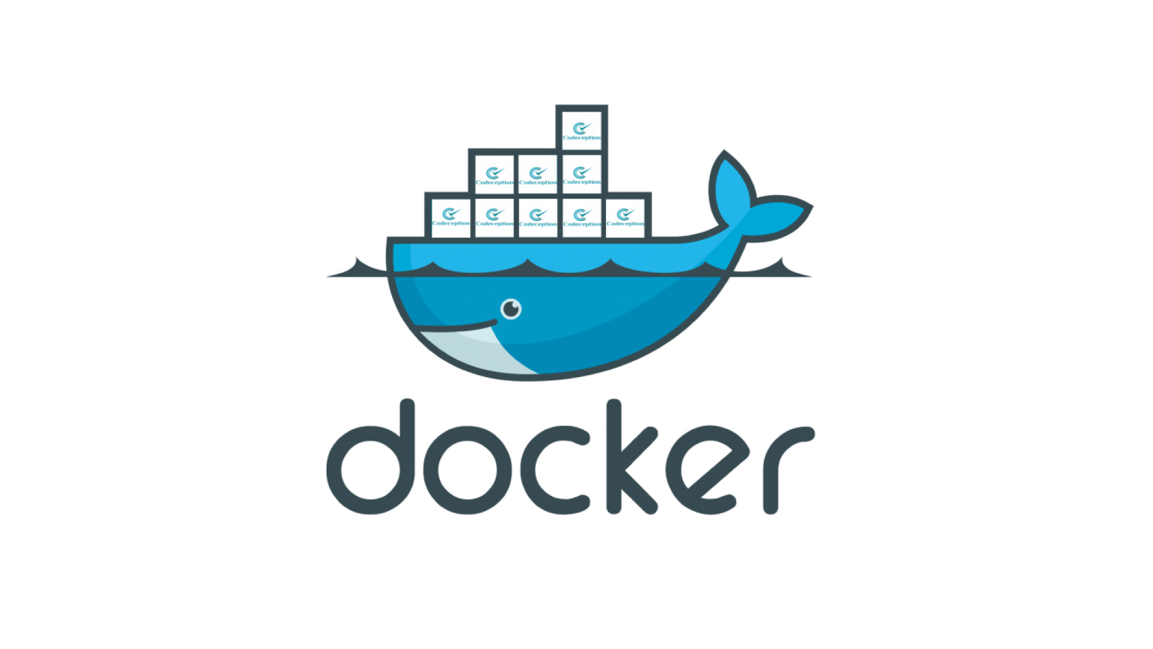
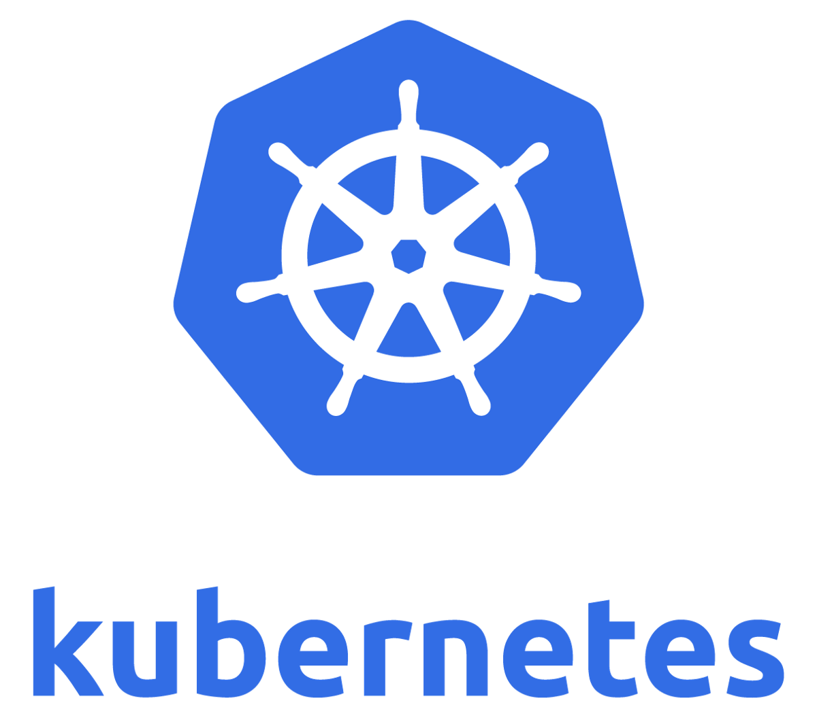



DevOps Playground
CI/CD Pipeline with Jenkins and Kubernetes

Slide 2

Andrea Zorzetto
Devops Consultant – ECS Digital
https://www.linkedin.com/in/andrea-zorzetto-a985671b/

Slide 3
Agenda
Build a Kubernetes Environment
Build and Deploy Jenkins from Dockerfile
Configure Jenkins
Provision Jenkins Jobs from Source Code
Run the Pipeline

Slide 4
Connect web console via Wetty:
URL: http://your_hostname_here.ldn.devopsplayground.com:3000
Password: DevopsPlayground19
Code base:
cd /home/centos/ecs-devops-playground-resources

Slide 5
1) Setup Kubernetes environment
Init Kubernetes Cluster
Configure kubectl command line
Configure Kubernetes Networking (Flannel CNI)
Make master schedulable

Slide 6
1) Init Kubernetes Cluster:
sudo kubeadm init --pod-network-cidr=10.244.0.0/16
2) Configure kubectl client
mkdir -p $HOME/.kube
sudo cp -i /etc/kubernetes/admin.conf $HOME/.kube/config
sudo chown $(id -u):$(id -g) $HOME/.kube/config
3) Configure Kubernetes Network (Flannel CNI)
kubectl apply –f \ https://raw.githubusercontent.com/coreos/flannel/master/Documentation/kube-flannel.yml
4) Make master schedulable
Kubectl get nodes
kubectl taint node <your-master-name> node-role.kubernetes.io/master:-

Slide 7
2) Build and Deploy Jenkins from Dockerfile
Setup Jenkins authentication/authorization in Kubernetes
Build Jenkins Docker image
Deploy Jenkins Pod

Slide 8

2.1) Jenkins service account authorization
Service account
Kubernetes cluster role
Kubernetes cluster role binding

Slide 9
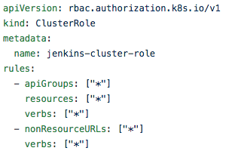
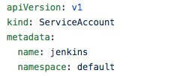
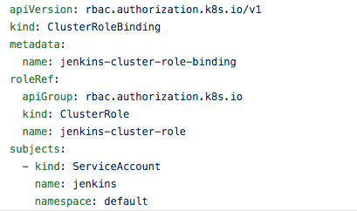


2.1) Jenkins service account authorization
authorization
authentication

Slide 10
kubectl create -f jenkins-build/rbac.yaml

Slide 11
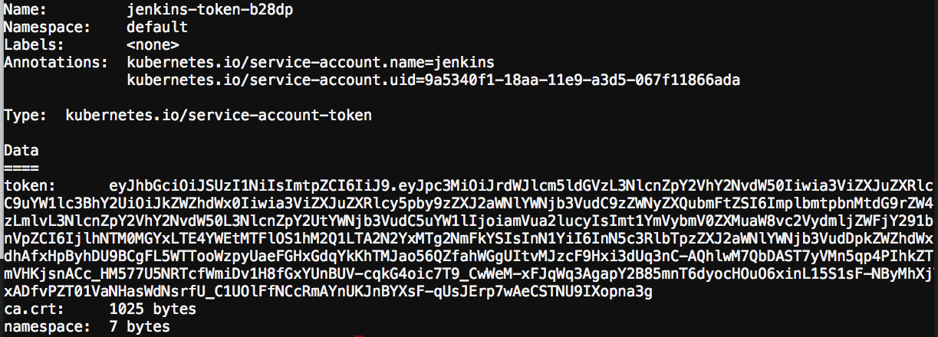

2.2.1) Jenkins service account Secret
kubectl get secrets
kubectl describe secret jenkins-token-b28dp

Slide 12
Get Jenkins’ Service Account token (find it in Github readme):
JENKINS_TOKEN=$(kubectl get secrets $(
kubectl get sa jenkins -o json|
jq -r '.secrets[].name') -o json |
jq -r '.data.token'|base64 –d
)
Equivalent of the manual steps below:
kubectl get secrets
kubectl describe secret jenkins-token-xxx
export JENKINS_TOKEN=yyy

Slide 13
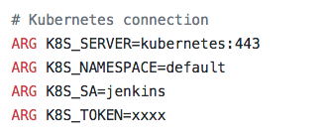

2.2.2) Jenkins Dockerfile
Build command:
docker build \
--build-arg K8S_TOKEN=$JENKINS_TOKEN \
-t jenkins:docker jenkins-build/.
Arguments specified in the Dockerfile:

Slide 14
2.3.1) Kubernetes Deployment for Jenkins
path: jenkins-build/deployment.yaml
Container info (image: version)
Replicas
Volumes
Security
…

Slide 15

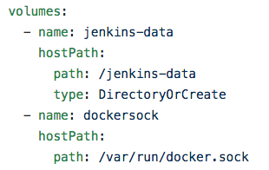
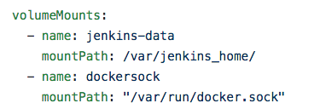


2.3.1) Kubernetes Deployment for Jenkins
The docker image we built

Slide 16
2.3.2) Kubernetes Service for Jenkins
path: jenkins-build/service.yaml
Name
Selector
Ports
Type

Slide 17


service
jenkins -> app:jenkins
app: jenkins
app: jenkins
app: jenkins
1
2
3
pods

Slide 18
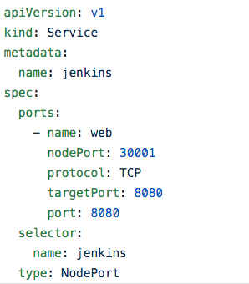



2.3.2) Kubernetes Service for Jenkins
Host port were Jenkins will be reachable at
Internal DNS name
Jenkins Pod Port
Selector used to identify the pods where to send the requests
Service Port

Slide 19
Create deployment and service
kubectl create -f jenkins-build/deployment.yaml
kubectl create -f jenkins-build/service.yaml
Find the admin password:
Kubectl get pods
kubectl logs –f jenkins-xxx-xxx

Slide 20
3) Configure Jenkins
Jenkins Setup Wizard
Admin user, and installation of requirements
Additional Plugins installation
Provision Jenkins Jobs automatically

Slide 21
3.1) Additional required plugins and steps
Install Plugins: Copy Artifact, Job dsl, Pipeline utility steps
kubectl exec -ti jenkins-xxx-xxx -- bash
java -jar /var/jenkins_home/war/WEB-INF/jenkins-cli.jar \
auth admin:admin \
-s http://127.0.0.1:8080/ \
install-plugin copyartifact job-dsl pipeline-utility-steps
Disable security
sed -i 's/<useSecurity>true/<useSecurity>false/' /var/jenkins_home/config.xml
Restart Jenkins
java -jar /var/jenkins_home/war/WEB-INF/jenkins-cli.jar \
auth admin:admin \
-s http://127.0.0.1:8080/ \
safe-restart

Slide 22
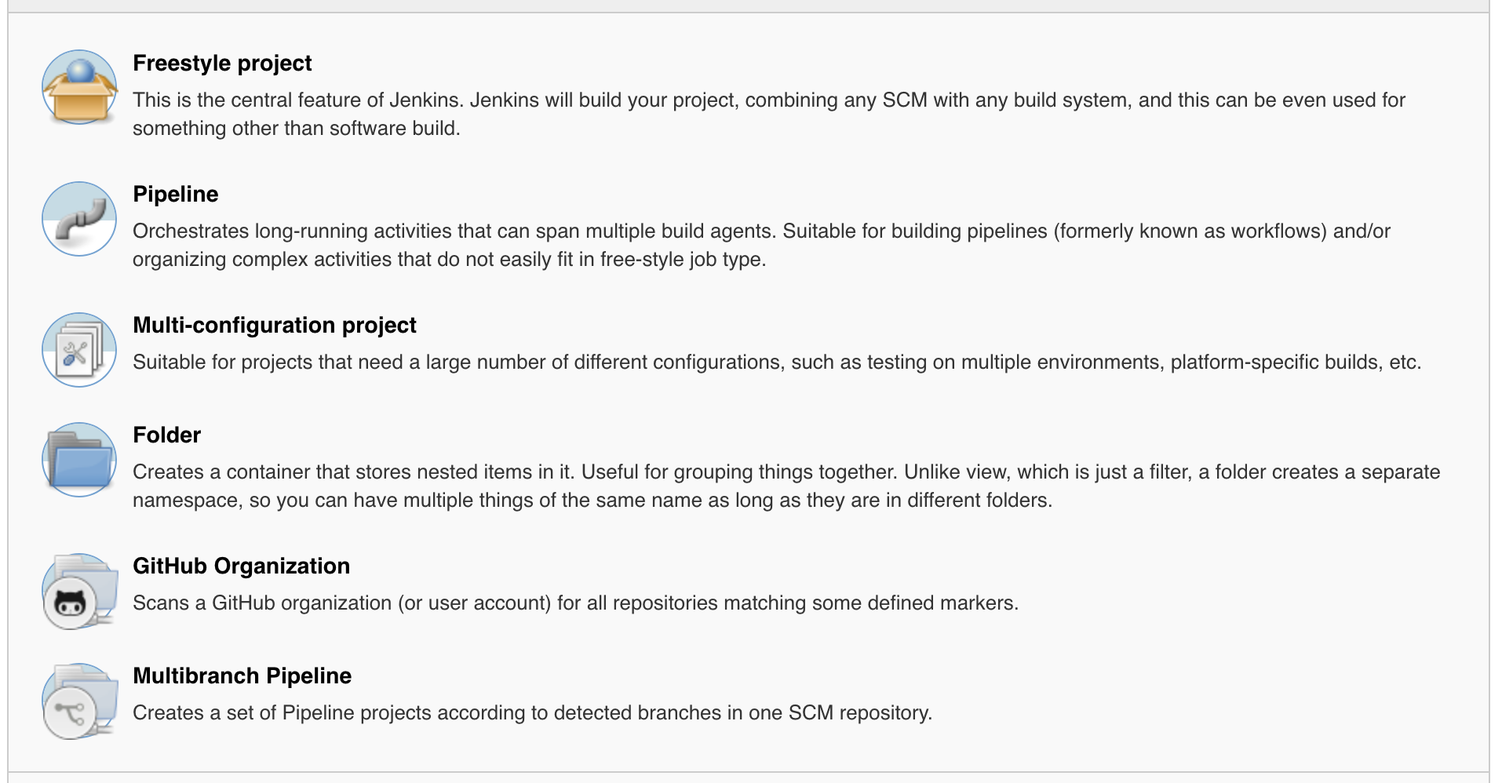

Slide 23
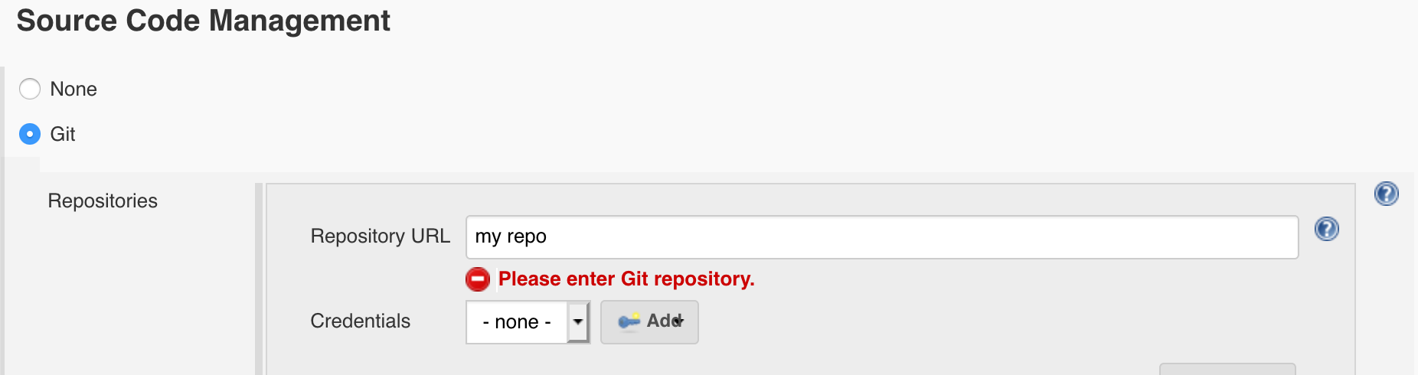
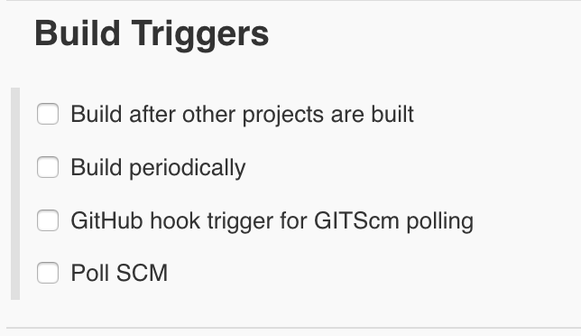
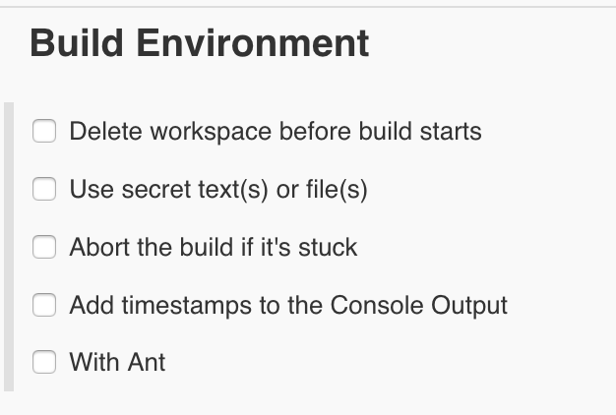
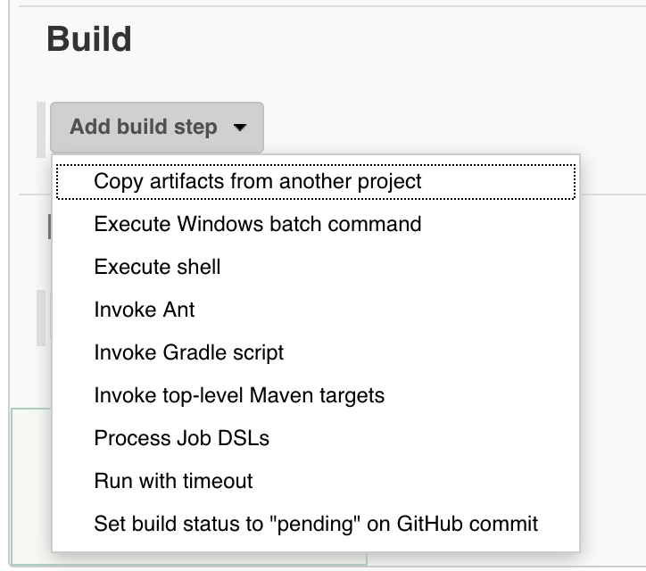

Slide 24


Slide 25
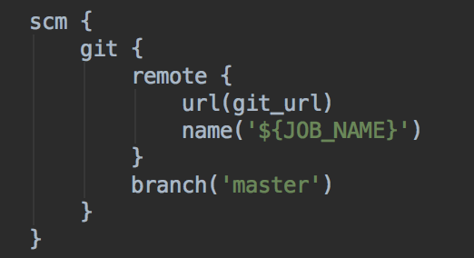

Slide 26
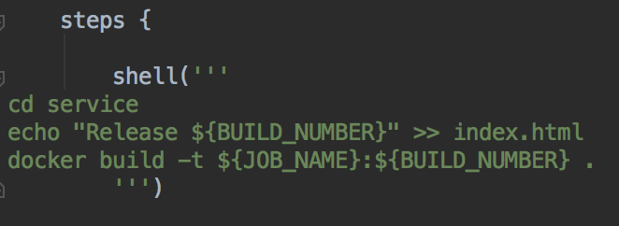

Slide 27
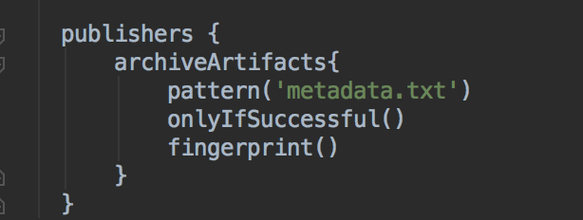

Slide 28
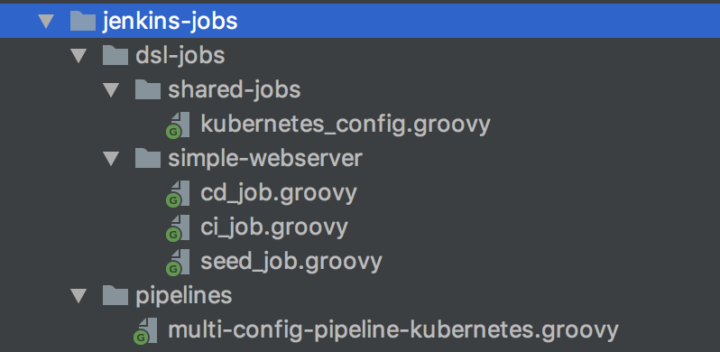

Slide 29
Provision Jenkins Jobs automatically

Slide 30
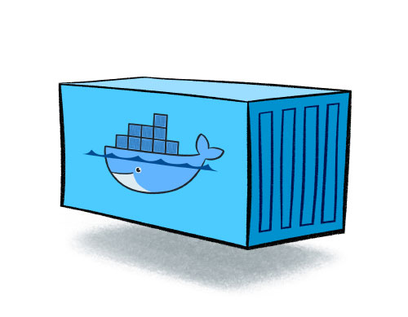

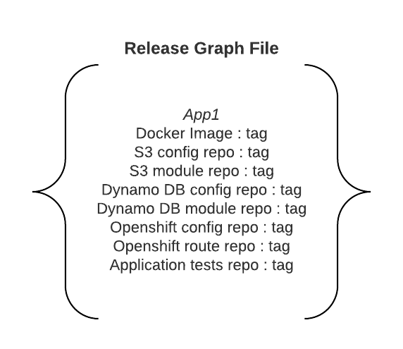
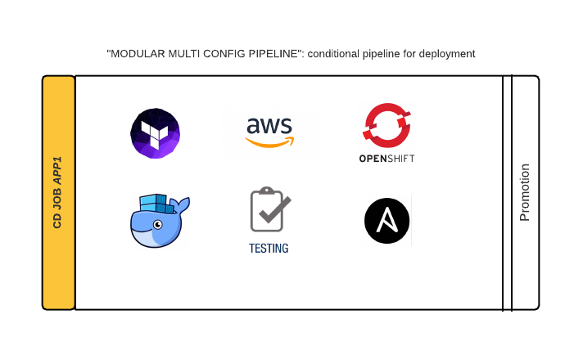


Seed jobs
Produce an artifact (docker image, code revision)
Return metadata
CI Jobs: create a full manifest file for the release
CD Jobs: run the pipeline according to the manifest

Slide 31
5) Run them all

Slide 32
6) What Next?
Kubernetes HA configuration
Helm Charts
Deployment of infrastructure components
Decoupled service and configs

Slide 33
Q/A

